Slide 2
What is Aurasma?
Augmented reality is a digitally enhanced view of the real world.
Turn any object, image, or place into an opportunity for AR.
Watch everyday things come to life with graphics, animation, video, audio, and 3D content.
Combine Aurasma with Microsoft Forms as formative assessment
Two ways to create an Aurasma- on your PC or on your Phone

Slide 3
Aurasma in the Classroom

Slide 4
Let’s Begin
Please Download the free Aurasma app from the App store or the Play Store
Create an account

Slide 5
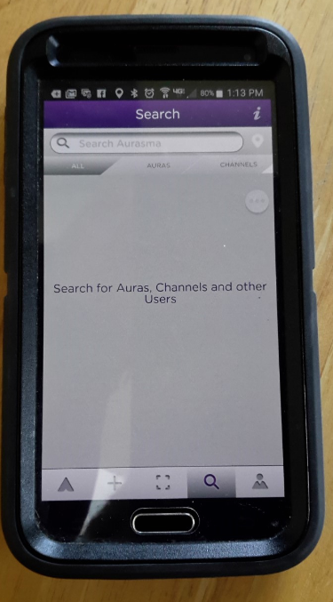
Using Your Device
Click here to search for Auras, Channels, and other users
2. Search for :
Unami Dr Cummins
3. Click Follow

Slide 6
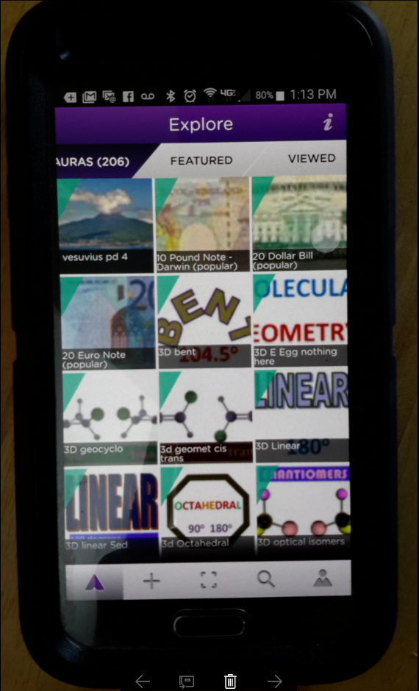
Using Your Device
Click here to view media via a trigger image

Slide 7
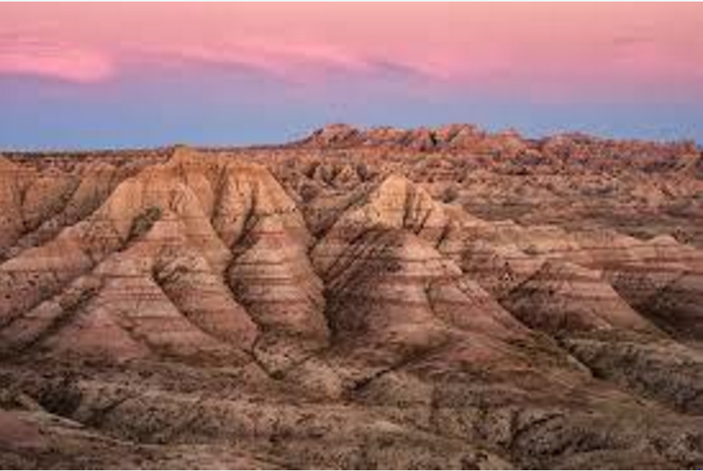
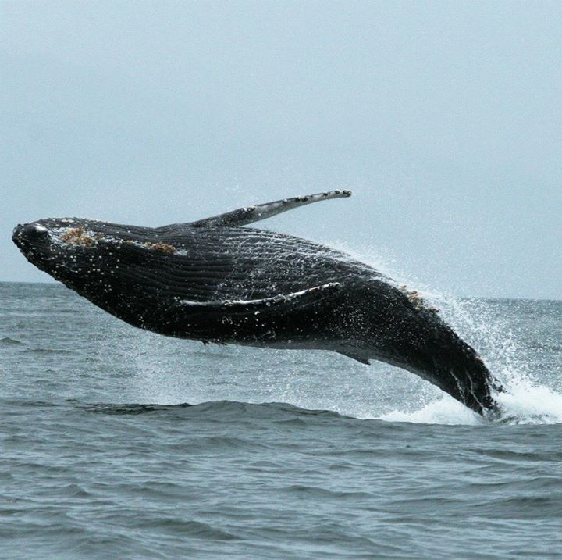
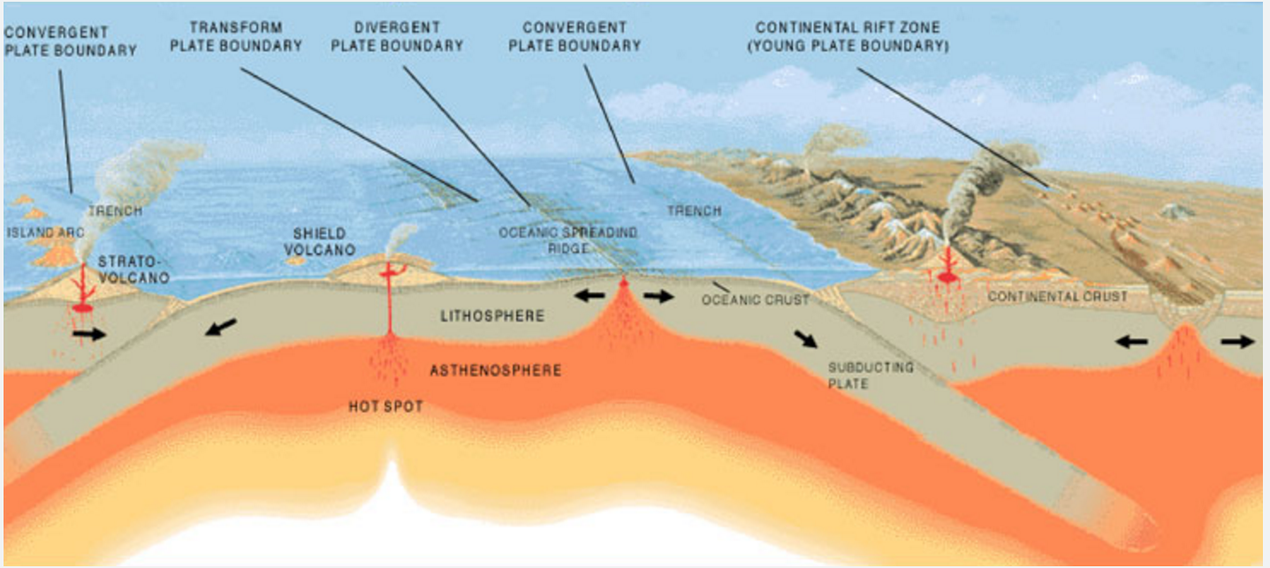
Aurasma’s from My Classroom
Use your device for the Aurasmas that are on the board :
Student Created using Movie Maker
Downloaded from YouTube
Poster
Homework Assignment

Slide 8
Examples of 3-D

Slide 9
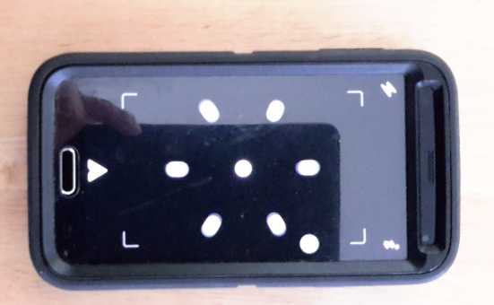
Using Your Device
Click here to go back to the Aurasma homepage

Slide 10
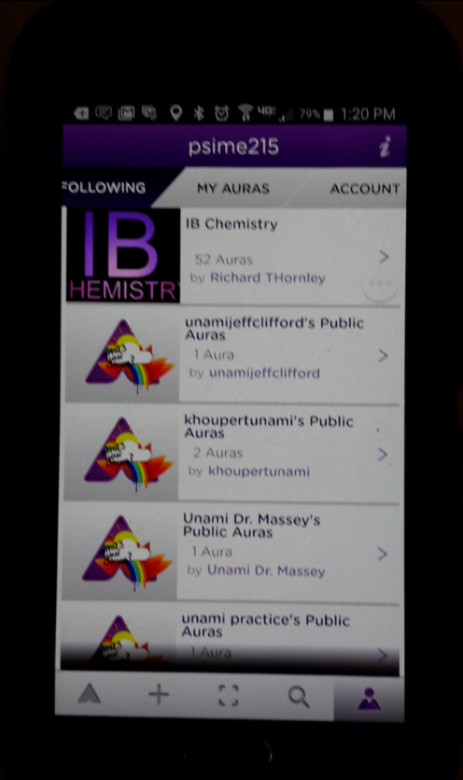
Using Your Device
See who you are following

Slide 11
Downloading from YouTube
***Be Careful of licensing. You don’t want to end up in YouTube School!

Slide 12
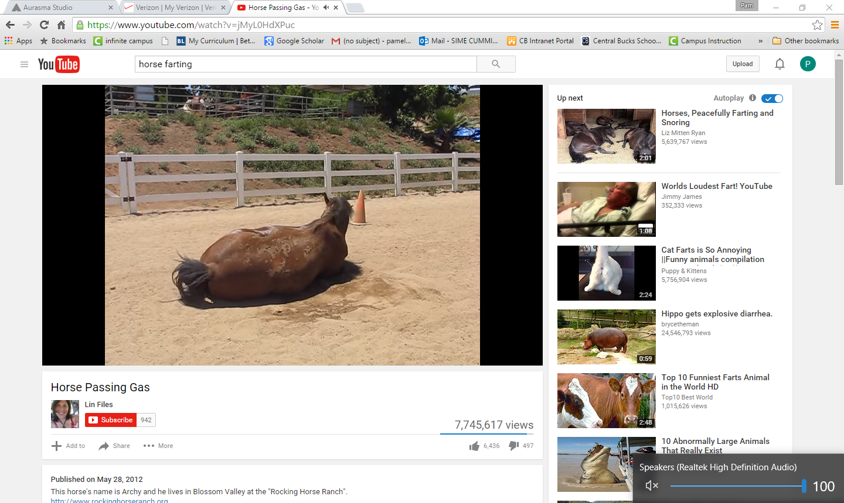
To download from YouTube
Copy the YouTube address of the video you want

Slide 13
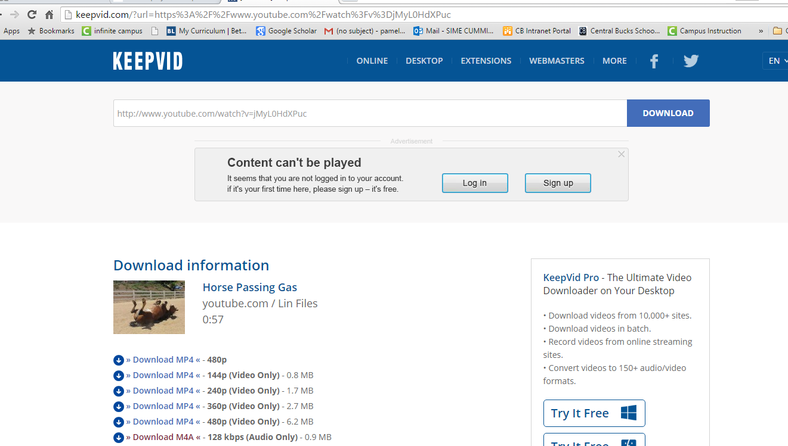
To download from YouTube
1. Go to keepvid.com
2. Paste the YouTube address of the video you want
then hit Download
3. Click download MP4 and save
the file to any folder

Slide 14
Create an Aurasma using a PC
Go to www.Aurasma.com and click sign up with the username and password you just made
Point to remember-Aurasma for students: I would suggest that you are the only one with the username and password and that you upload student videos.

Slide 15
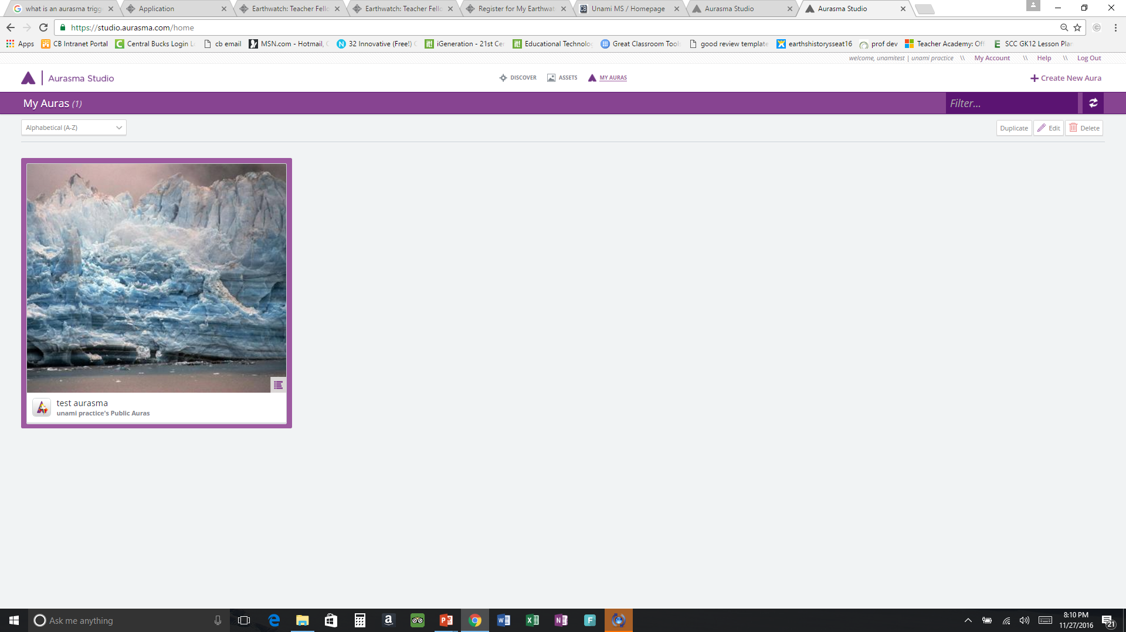
Create an Aurasma using a PC
Click My Account

Slide 16
Create an Aurasma using a PC
Click Enable Features then…
Click advanced aura actions and web overlays

Slide 17
Create an Aurasma using a PC
Click Create New Aura

Slide 18
Create an Aurasma using a PC
Click to upload trigger.
Trigger Images are the real world images or objects you want Aurasma to be able to recognize.

Slide 19
Create an Aurasma using a PC
Click browse
Choose the picture you want, name it and hit save

Slide 20
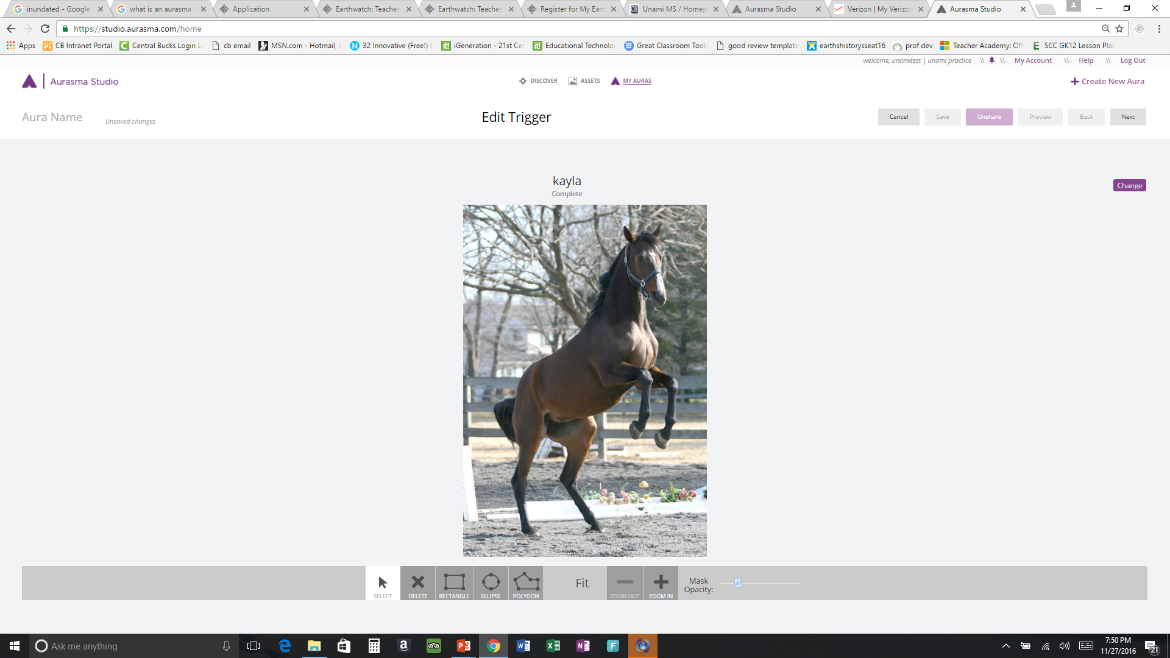
Create an Aurasma using a PC
If happy with it, hit next
If not happy with it, hit change

Slide 21
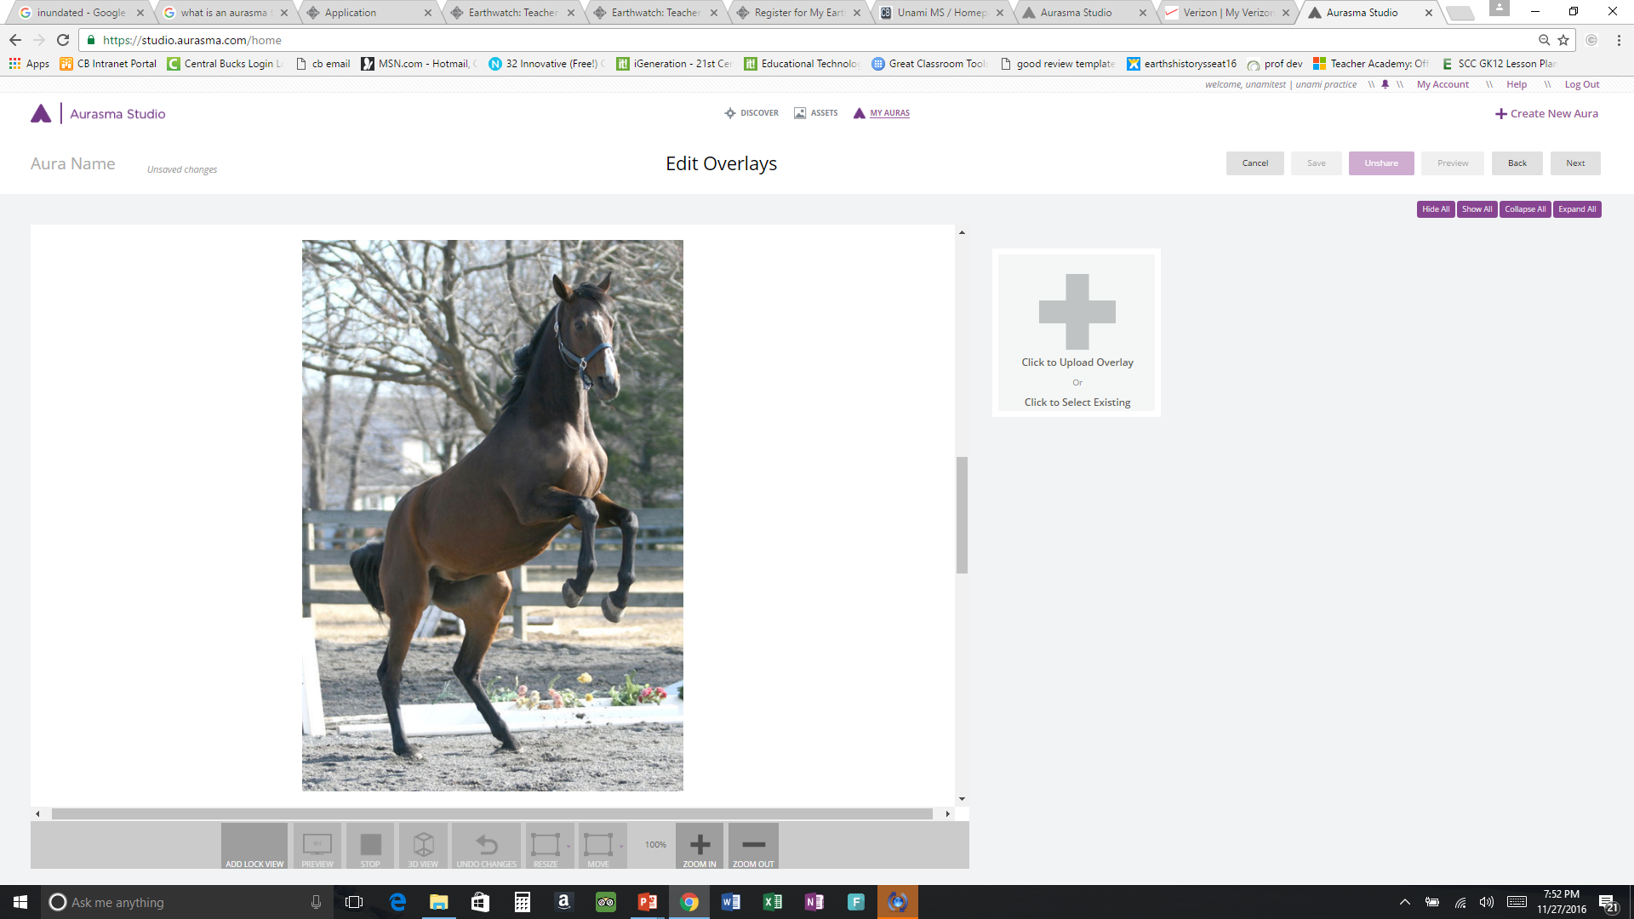
Create an Aurasma using a PC
Click to upload overlay
The Overlay is what will be shown when the trigger is activated

Slide 22
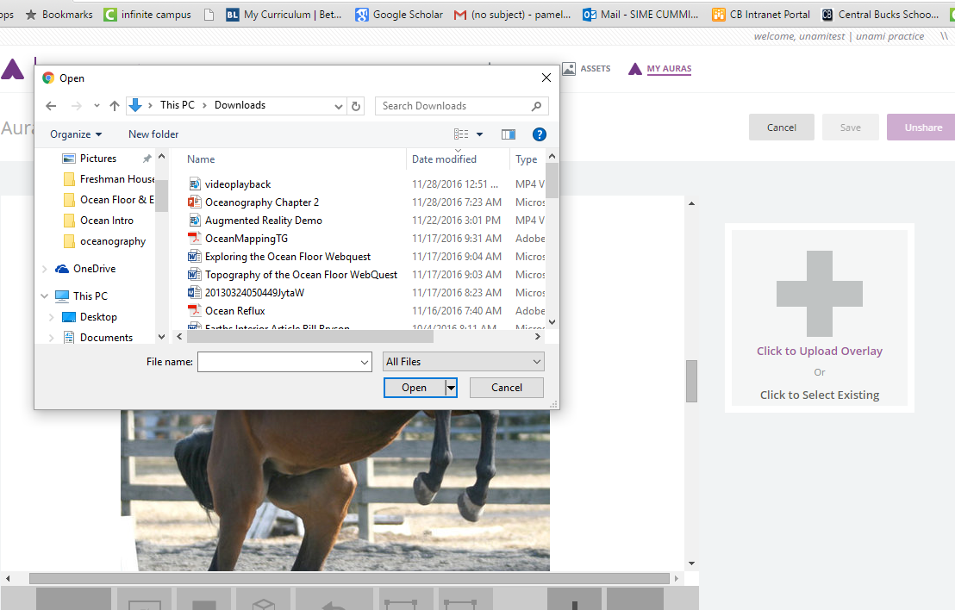
Create an Aurasma using a PC
Choose the video you want and click open

Slide 23
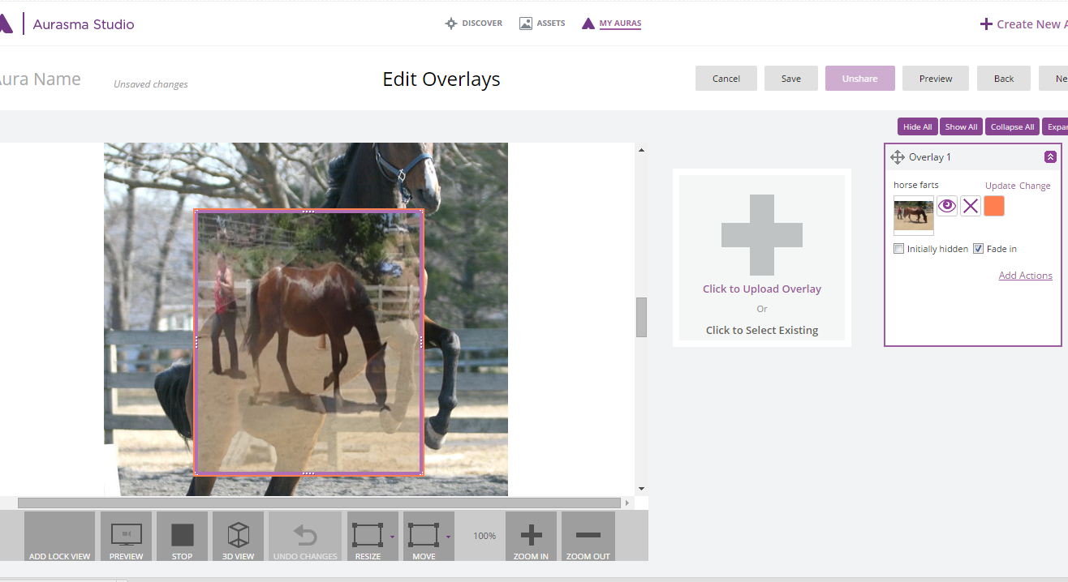
Create an Aurasma using a PC
Resize by pulling on the handles

Slide 24
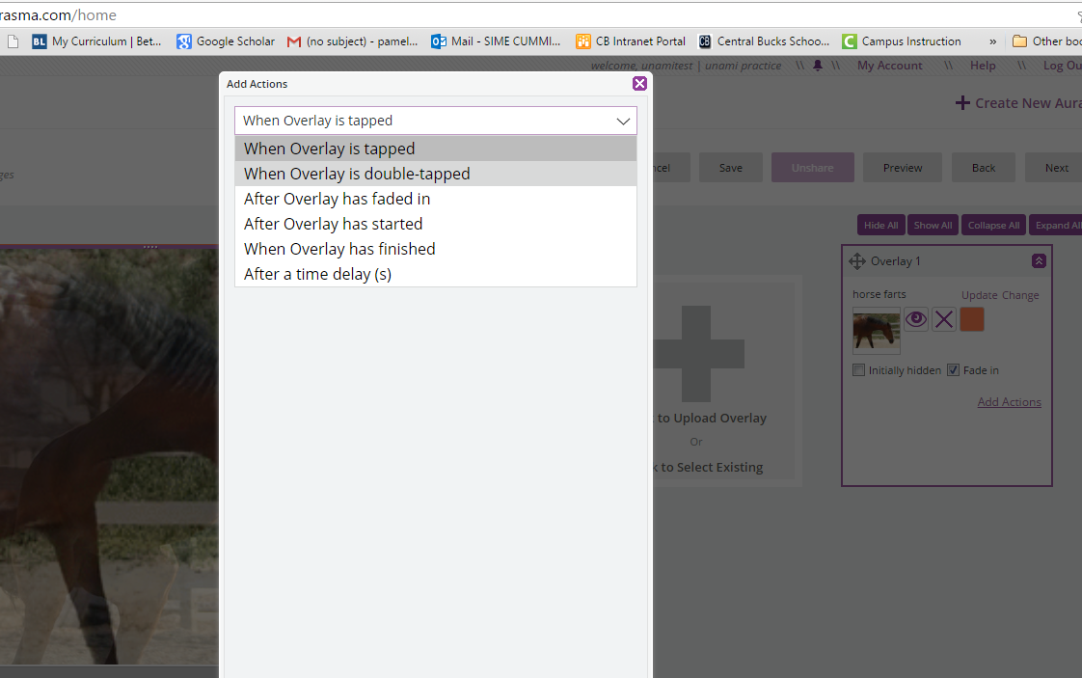
Adding Actions to an Overlay
Actions tell Aurasma when the overlay will begin. They are especially helpful when adding more than one overlay to your project
To add actions click
here
Choose the action you want to use

Slide 25
Adding More Than One Overlay to a Trigger
When you are finished, hit next
To add subsequent overlays to the same trigger, click here

Slide 26
Add a Website, 3-D models, previously viewed overlays
Click to add website, 3-D models, animations, as well as previously used overlays

Slide 27
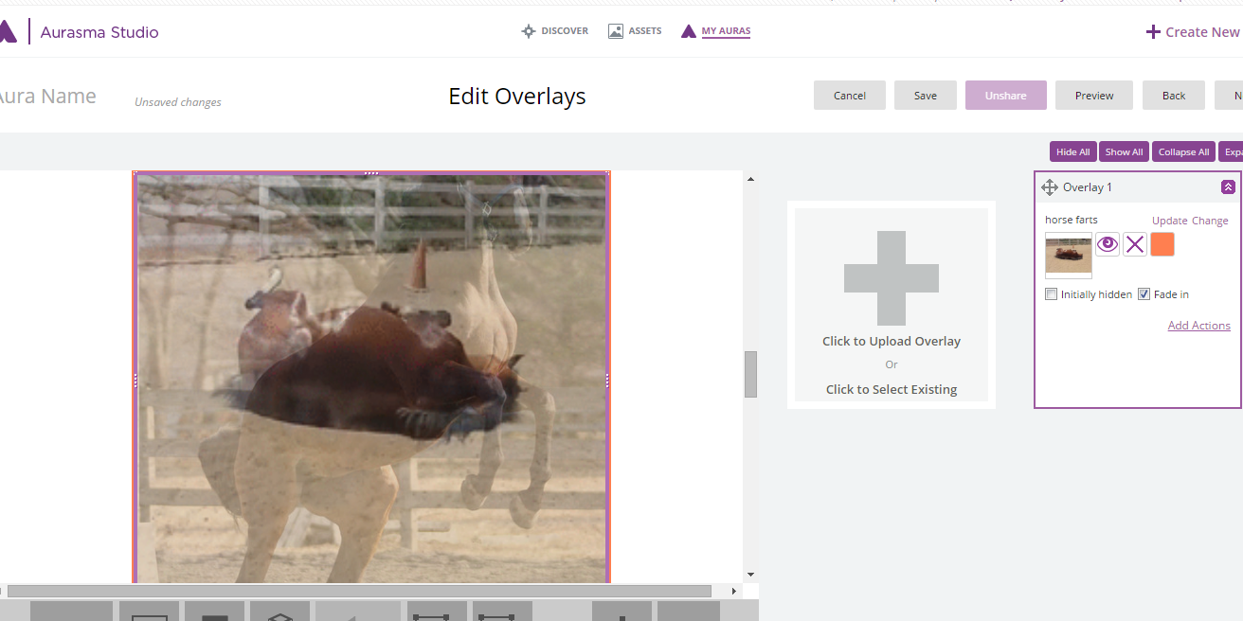
To Add a Website as an Overlay
Go to assets

Slide 28
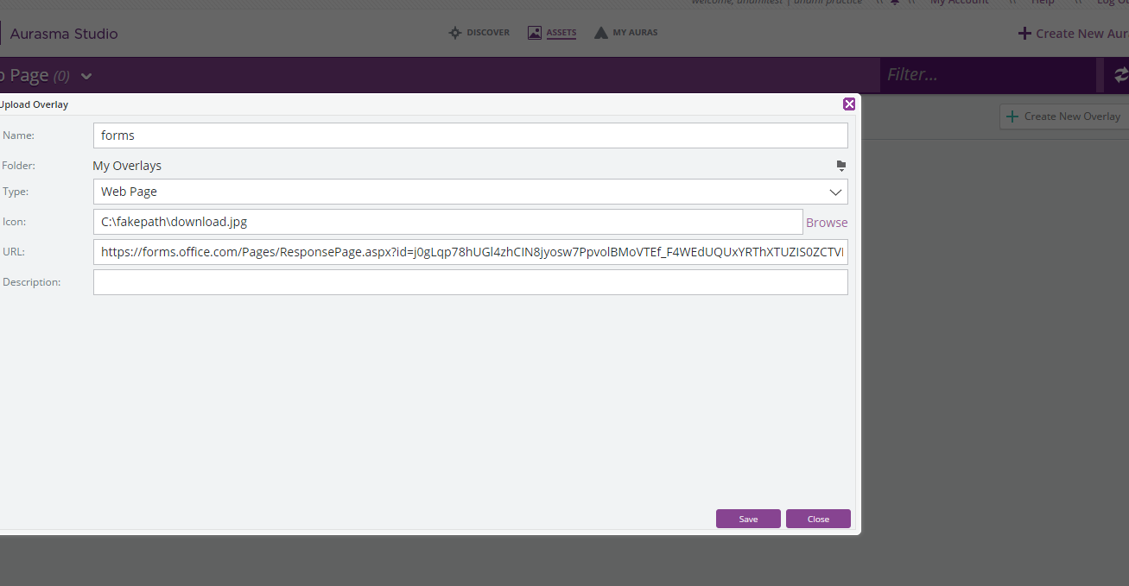
To Add a Website as an Overlay
2. Name the overlay
3. Choose from dropdown
Click Create
New
Overlay
4. Browse for icon
5. Paste the URL
6. save

Slide 29
To Add a Website as an Overlay
Click here

Slide 30
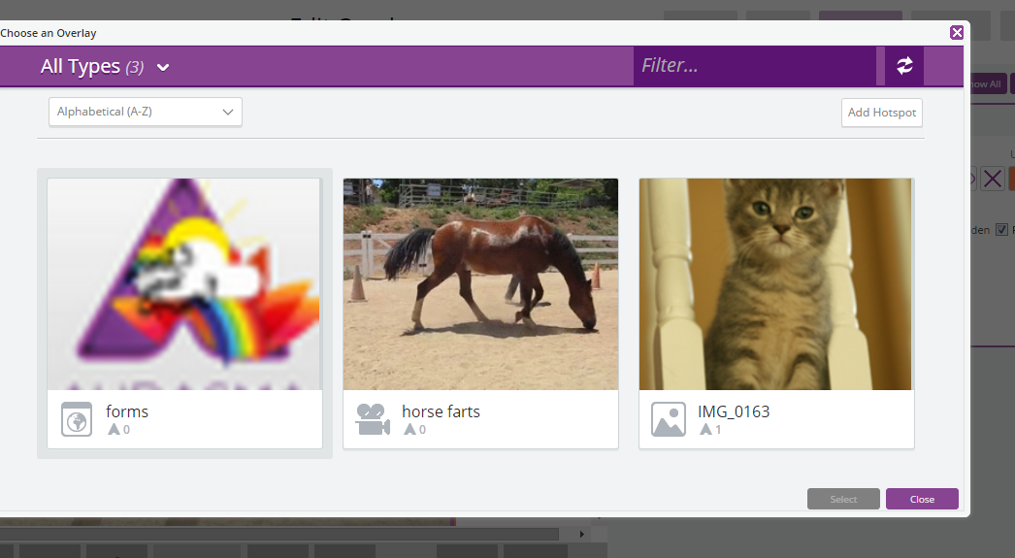
To Add a Website as an Overlay
Choose the Overlay and hit select

Slide 31
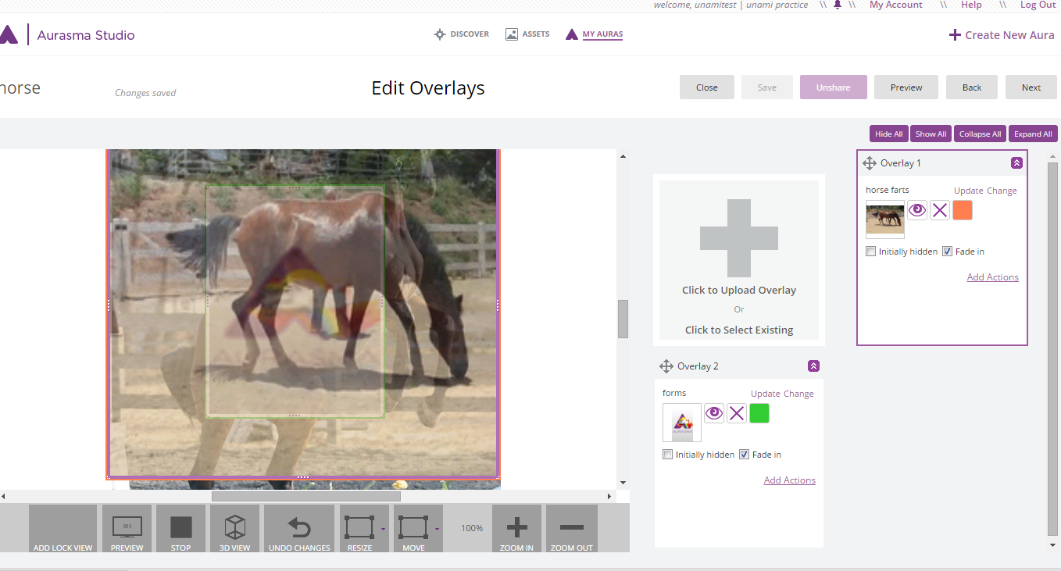
To Add a Website as an Overlay
When you are happy with it, click next
Drag to change the order of the overlays if you want to

Slide 32
How to create augmented reality in Aurasma Studio

